Slide 1


CINESAGE
A Machine Learning based Movie Recommendation System
By : Sai Nikhil Sadhula

Slide 2
About me
Background:
Academic Qualification: B.Tech
Motivation for Learning Data Science:
Fascination with uncovering insights from data
Excitement about problem-solving and innovation in the field
Work Experience:
Status: Fresher
Data Science Intern at Innomatics Research Labs
Profile Links:
GitHub: github.com/saigitnik
LinkedIn: linkedin.com/in/sai-nikhil-sadhula

Slide 3
Contents
Introduction
Business Problem
Objective and Content based Filtering
Proposed Solution and Expected Outcome
About the Data
Data Preprocessing
Feature Engineering
Text Vectorization
Recommended Function
Deployment
Output
Conclusion

Slide 4
Introduction
Movies are a big part of our entertainment world. We all have our favorite movies, but sometimes it's hard to find new ones we'll like. That's where smart systems come in. These systems look at the movies we already enjoy and suggest similar ones for us to watch. They do this by understanding what makes movies similar, like the type of story they tell or the actors in them. This helps us discover new movies we'll love, keeping us entertained and happy.

Slide 5
Business Problem
In the movie world, companies want to recommend movies to people that they'll really enjoy watching. But figuring out what someone will like can be tricky. So, they need a smart system that can look at movies people have already liked and suggest similar ones. This system uses clever tricks to analyse lots of movie data, like the type of movie, the actors in it, and what it's about. By understanding what makes movies alike, the system can make better suggestions, keeping viewers happy and engaged with the platform. Additionally, as it learns from people's preferences over time, it keeps getting better at recommending movies tailored to each individual's tastes, ensuring a more enjoyable viewing experience for everyone.

Slide 6
Objective
Smart Recommendations: Create a system that suggests movies based on what people have already watched and liked.
Understanding Movies: Figure out what makes movies similar to each other, like their genre, actors, and story.
Making It Better: Keep improving the system by seeing how well it matches people's tastes and making it work even better.
Content based Filtering
User Profiles: Develops detailed profiles of users' movie preferences by analysing factors such as genres, actors, directors, and themes they prefer, based on their viewing history.
Similarity Matching: Identifies users with similar tastes by comparing their movie preferences and recommends films that align with their interests, leveraging similarities in genres, cast, and plot characteristics.
Personalized Suggestions: Delivers personalized movie recommendations tailored to each user's unique interests and preferences, ensuring a satisfying viewing experience by suggesting films that closely match their individual tastes and preferences.

Slide 7
Expected Outcome
Proposed Solution
We'll use machine learning tricks to analyse lots of movie data and build a smart system. It will learn from what people watch and like, and then use that to suggest other movies they might enjoy.
Happier Viewers: People will be happier because they'll get suggestions for movies they're likely to enjoy.
Keeping People Around: People will stick around on the platform longer because they'll find more movies they want to watch.
Beating the Competition: Our platform will be better than others because our suggestions will be spot-on and keep people coming back for more.

Slide 8
About The Data
Gathered movie datasets from Kaggle, containing information such as titles, overviews, genres, keywords, cast, crew and other features.
tmdb_5000_movies.csv: Includes data on 5000 movies and 20 columns, featuring various features such as movie_id, revenue, and popularity, facilitating trend analysis and recommendation system development in the film industry.
tmdb_5000_credits.csv: Provides credits for the same movie set, detailing cast and crew members, enhancing analysis with information on actor collaborations and production team contributions.
Loading and Merging of Data
The datasets 'tmdb_5000_movies.csv' and 'tmdb_5000_credits.csv' were loaded and merged based on movie titles to consolidate movie information and credits into a single dataset for analysis using pandas.
The datasets were merged based on the movie title to combine relevant information into a single Data Frame.
Data Preprocessing
Dropped unnecessary columns like 'id'.
Extracted relevant features like 'movie_id', 'title', 'overview', 'genres', 'keywords', 'cast', and 'crew'.
Checked for missing values and dropped rows with missing overview information.

Slide 9
Feature Engineering
Converted stringed lists in 'keywords', 'cast', and 'crew' columns into lists using the ast.literal_eval() function.
Extracted top 3 cast members from the 'cast' column.
Extracted directors from the 'crew' column based on the job title.
Combined relevant features ('overview', 'genres', 'keywords', 'cast', and 'crew') to create a new feature called 'tags'.
Text Vectorization:
Concatenated all 'tags' into a single string.
Lowercased the text to ensure consistency.
Utilized Count Vectorizer to convert text data into a matrix of token counts, considering the top 5000 features and excluding English stop words.

Slide 10
Similarity Calculation
Computed cosine similarity between movie tags to determine the similarity matrix.
This matrix serves as the foundation for the recommendation system, enabling the identification of similar movies for a given input.
The recommendation function utilizes this similarity matrix to suggest relevant movies to users based on their preferences.
Recommendation Function
Input: The function takes the title of a movie as input.
Index Retrieval: It locates the index of the input movie in the data frame containing movie information.
Similarity Calculation: Using the index of the input movie, the function retrieves the corresponding row from the cosine similarity matrix, which contains similarity scores between the input movie and all other movies in the dataset.
Sorting: The function sorts the similarity scores in descending order to identify the movies most similar to the input movie.
Output: Finally, the function outputs the titles of the top recommended movies based on their similarity scores. By default, it returns the titles of the top 5 recommended movies, excluding the input movie itself.
Usage: Users can call this function and provide the title of a movie they enjoyed. The function then generates a list of recommended movies that share similar content characteristics with the input movie.
Model Serialization
Serialized the processed data and similarity matrix using the pickle module for future use.

Slide 11
Deployment
Integration with TMDB API for Movie Posters:
The system utilizes the TMDB API to fetch movie poster URLs based on movie IDs.
A custom function fetch_poster() is implemented to handle API requests and retrieve poster URLs for recommended movies.
Movie Recommendation Logic:
The system employs a content-based recommendation approach using cosine similarity.
Upon receiving a selected movie title from the user, the recommend() function computes similarity scores between the selected movie and others in the dataset.
It returns the titles and poster URLs of the top 5 recommended movies based on similarity scores.
Flask App Structure:
The Flask application consists of two main routes:
/: Renders the movie selection page where users can choose a movie from a dropdown list.
/recommend: Handles the form submission and displays the recommended movies on a separate page.
Data Loading and Serialization:
Movie data and the similarity matrix are loaded from serialized files (film.pkl and similarity.pkl) stored locally.
Error handling is implemented to ensure graceful termination if the required files are not found.

Slide 12
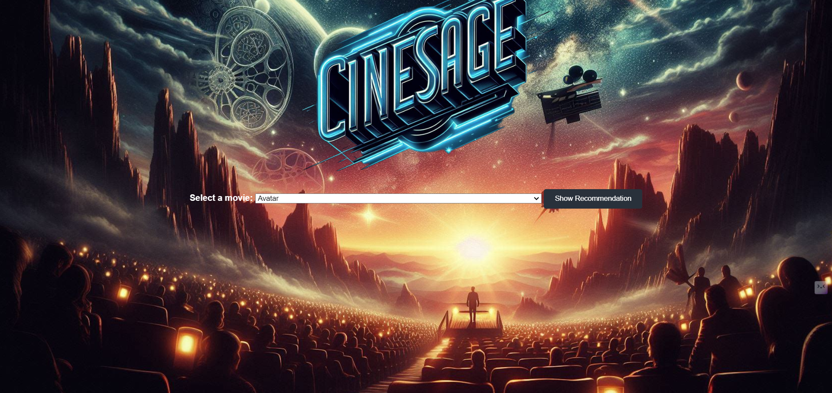
Output

Slide 13
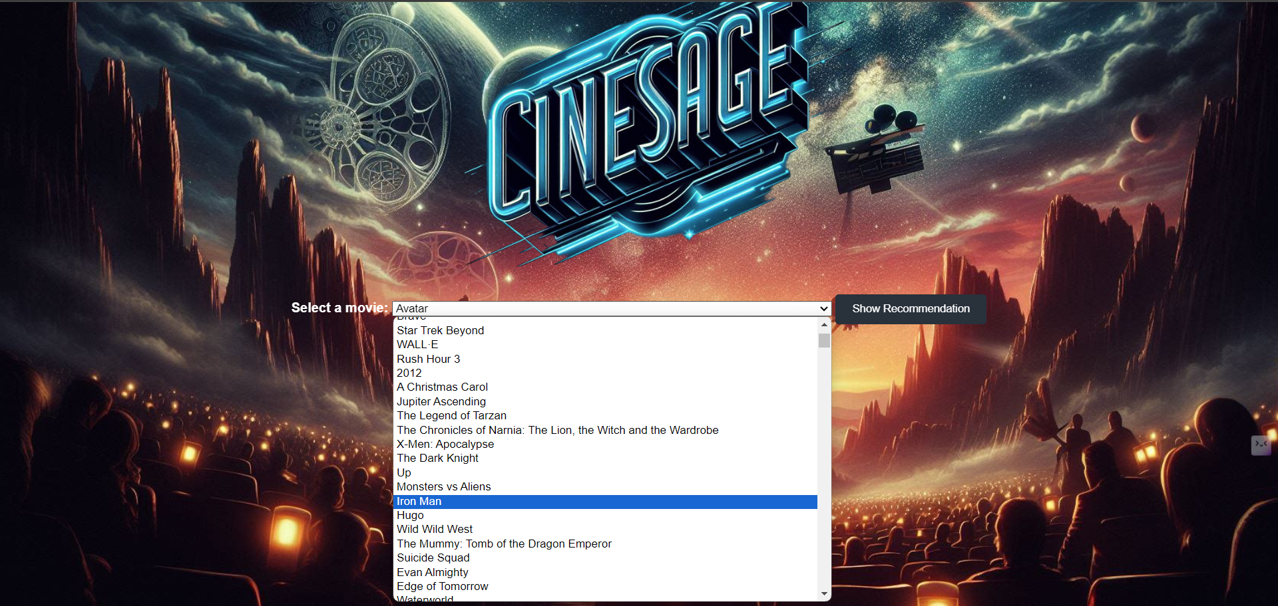

Slide 14
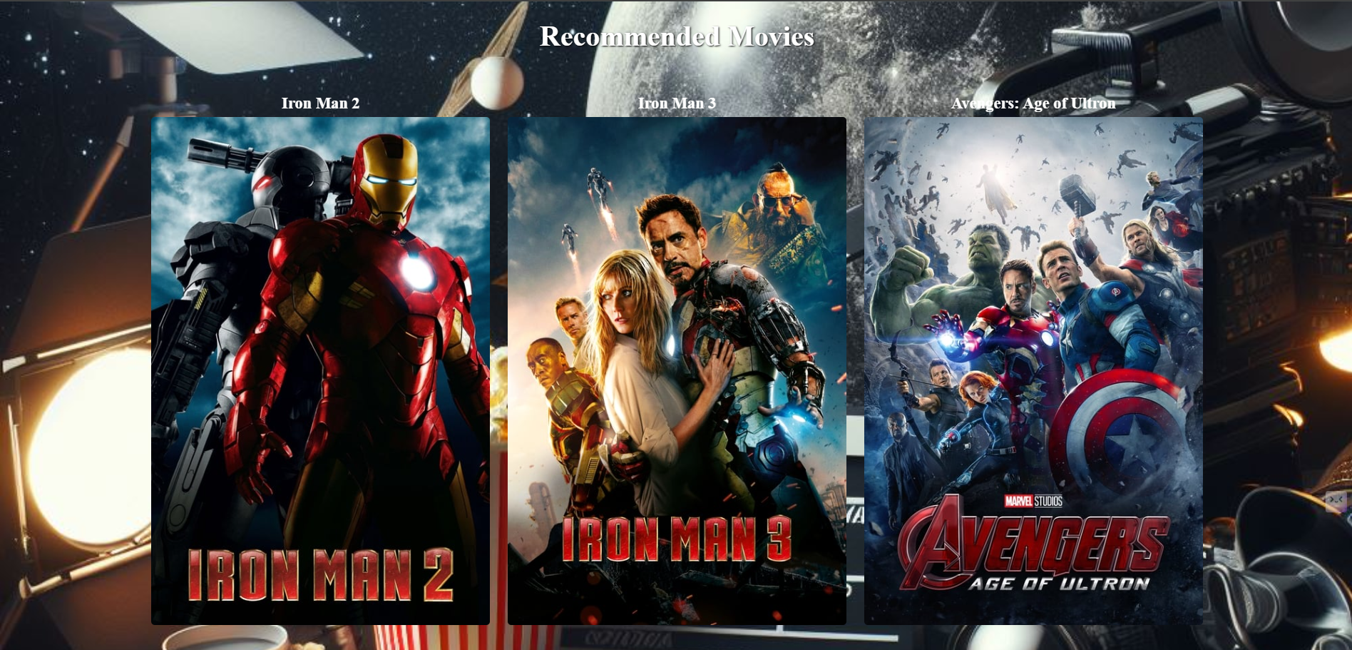

Slide 15


Slide 16
Conclusion
The movie recommendation system we built helps people find movies they'll enjoy watching. It works by looking at what movies they already like and suggesting similar ones. This makes it easier for users to discover new movies they might love, keeping them happy and entertained. By using clever machine learning tricks to analyse lots of movie data, our system gets better at making recommendations over time. This helps keep users around longer and sets our platform apart from others, making it a go-to destination for movie lovers.
Project Link [GitHub]: https://github.com/saigitnik/Movie-Recommendation-System

Slide 17


